Slide 1



Introduction to Stream Processing
with Kafka Streams
@binitakaushik18
Binita kaushik

Slide 2
Agenda
Stream Processing
Streams vs Batch
Windowing
Kafka and Kafka Streams in brief
Kafka Streams concepts
Demo on Kafka streams
Closing notes

Slide 3
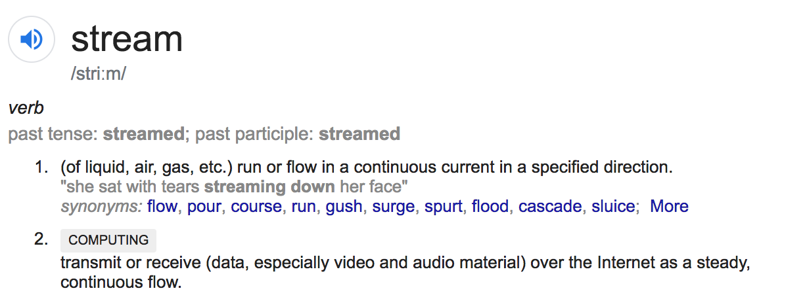
What is Stream Processing

Slide 4
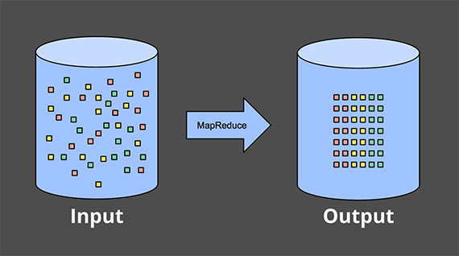
What makes Stream Processing complex
Batch(Bounded data)

Slide 5
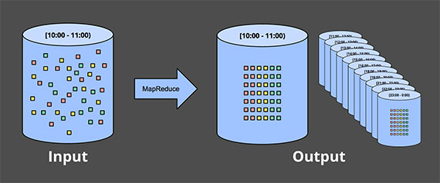
Streams (Unbounded data)

Slide 6
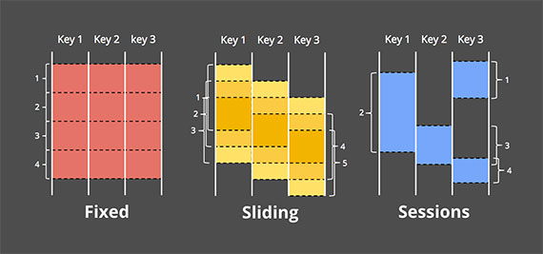
Windowing in Streams
taking a data source and chopping it up along temporal boundaries into finite chunks for processing
Image: Tyler Akidau

Slide 7

Does it solve your problem?
Quicker feedback loop
Real time trends
Identify security issues
Identify patterns over data set
Predictive analysis
Economic forecasting
VS

Slide 8
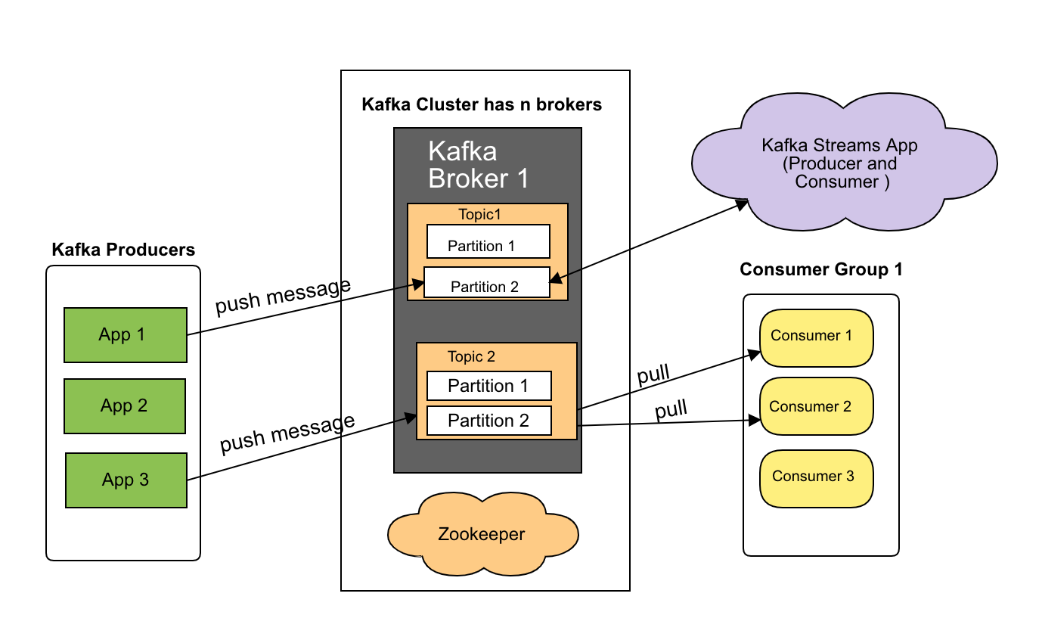
Kafka and Kafka Streams

Slide 9
Kafka Streams Concepts in brief
Streams DSL
KStreams
Ktable
Topology
Stateful and stateless stream processing
RocksDB

Slide 10
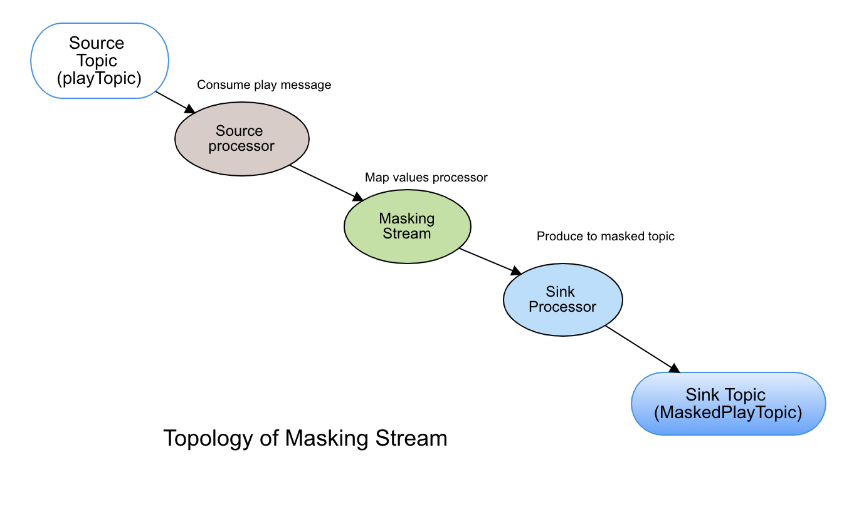
Demo masking PII Streams Topology
Demo video attach here

Slide 11
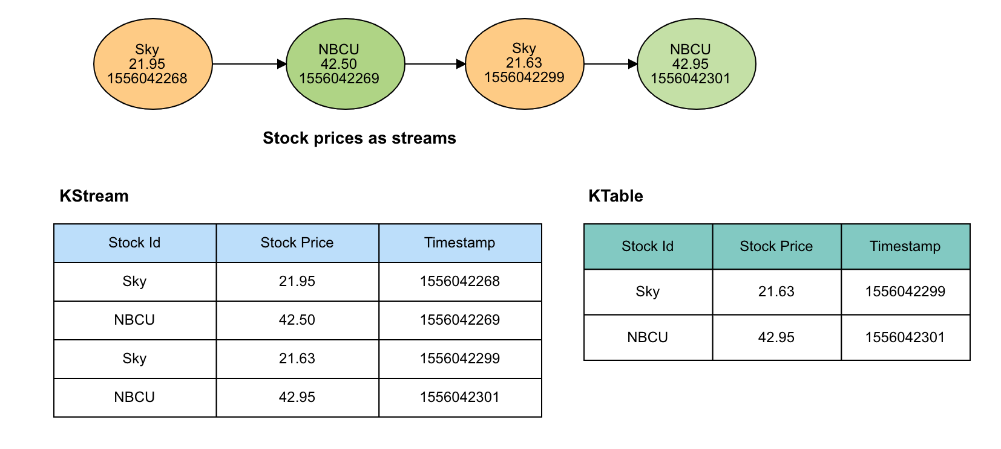
KStream (Insert) vs KTable (Upsert)

Slide 12
Stateful & Stateless stream processing
Joining streams
Kstreams and Ktable joining
RocksDB
Lightyear can process 400 million messages in under 4 hours.

Slide 13
References
https://www.oreilly.com/ideas/the-world-beyond-batch-streaming-101
https://docs.confluent.io/current/streams/index.html
https://www.manning.com/books/kafka-streams-in-action
https://www.oreilly.com/ideas/why-local-state-is-a-fundamental-primitive-in-stream-processing

Slide 14

Questions Demo at https://github.com/binitakaushik18
May all your streams come true

